Slide 1

Web Scraping with Scrapy
Mihai Todor
08.10.2016

Slide 2
What is web scraping?
Web scraping (web harvesting or web data extraction) is a computer software technique of extracting information from websites.
This is accomplished by either directly implementing the Hypertext Transfer Protocol (on which the Web is based), or embedding a web browser.
https://en.wikipedia.org/wiki/Web_scraping

Slide 3
Primitive “web scraping”
> wget -O output.html https://wikitech.wikimedia.org/wiki/Server_Admin_Log
> sed -n 's:.*<h2>\(.*\)</h2>.*:\1:p' output.html
…
<span class="mw-headline" id="2016-08-29">2016-08-29</span>
<span class="mw-headline" id="2016-08-28">2016-08-28</span>
<span class="mw-headline" id="2016-08-27">2016-08-27</span>
<span class="mw-headline" id="2016-08-26">2016-08-26</span>
<span class="mw-headline" id="2016-08-25">2016-08-25</span>
<span class="mw-headline" id="2016-08-24">2016-08-24</span>
<span class="mw-headline" id="2016-08-23">2016-08-23</span>
<span class="mw-headline" id="2016-08-22">2016-08-22</span>
<span class="mw-headline" id="2016-08-21">2016-08-21</span>
<span class="mw-headline" id="2016-08-20">2016-08-20</span>
<span class="mw-headline" id="2016-08-19">2016-08-19</span>
<span class="mw-headline" id="2016-08-18">2016-08-18</span>
…

Slide 4
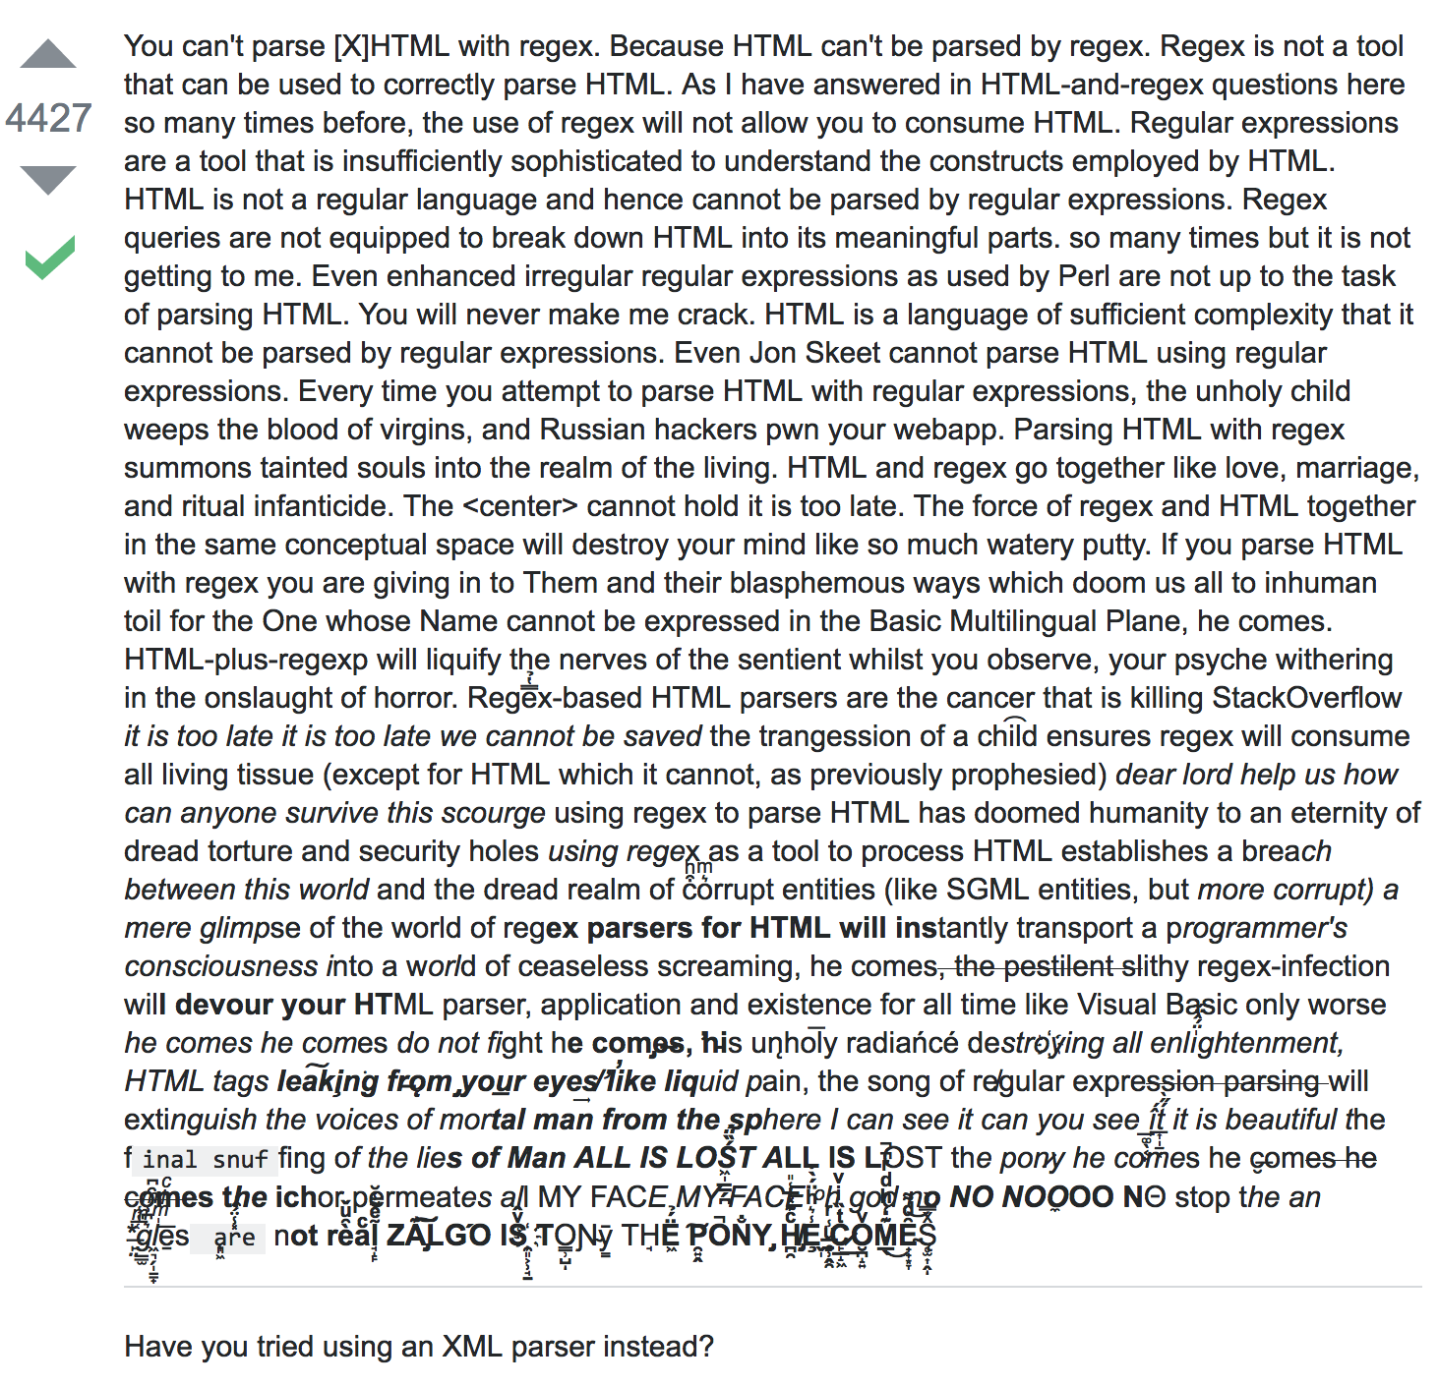
Don’t parse HTML with RegEx!!!
http://stackoverflow.com/questions/1732348/regex-match-open-tags-except-xhtml-self-contained-tags/

Slide 5
Web scraping technologies
Lots of tools, frameworks and online services…
https://github.com/lorien/awesome-web-scraping
Python web scraping frameworks:
Scrapy
pyspider
beautifulsoup4
selenium
…

Slide 6
Scraper examples
Many open source examples written by the Archive Team (archiveteam.org):
https://github.com/ArchiveTeam

Slide 7
Not always easy…
Some web pages are loaded dynamically, using JavaScript
web pages
web apps
Others might require passing around some obfuscated state

Slide 8
War Stories
Mihai’s experiments with PHP’s DOMDocument from 7 years ago… ☺

Slide 9
Scrapy
An open source and collaborative framework for extracting the data you need from websites.
In a fast, simple, yet extensible way.
http://scrapy.org/

Slide 10
Scrapy – “fancy wget”
> pip install scrapy
> scrapy fetch --nolog https://wikitech.wikimedia.org/wiki/Server_Admin_Log
…
<li> 14:48 paravoid: Upgrading cr2-codfw FPC 0 all PICs firmware</li>
<li> 14:42 paravoid: Disabling cr2-codfw et-0/2/0, et-0/2/1 (row C/D uplinks)</li>
<li> 14:34 paravoid: Disabling cr2-codfw et-0/0/0 (row A uplink)</li>
<li> 14:29 paravoid: Disabling cr2-codfw et-0/0/1 (row B uplink)</li>
<li> 14:15 paravoid: Disabling OSPF on all cr2-codfw row subnets to drain FPC0</li>
<li> 14:08 ema: depooled reboot of cp1* hosts (T131928)</li>
<li> 12:49 paravoid: draining cr2-codfw for firmware upgrade</li>
<li> 12:26 bblack: upgrade nginx to 1.11.1-1+wmf1 on all clusters</li>
<li> 11:50 elukey: rebooting kafka1022 for kernel upgrade (4.4)</li>
…

Slide 11
Scrapy basics
> scrapy startproject tutorial
New Scrapy project 'tutorial', using template directory '/usr/local/lib/python3.5/site-packages/scrapy/templates/project', created in:
/Users/mtodor/Projects/meetups/tutorial
You can start your first spider with:
cd tutorial
scrapy genspider example example.com
> cd tutorial
> scrapy genspider example example.com
> scrapy crawl example -t json -o output.json

Slide 12
Scrapy basics cont’d
> cd tutorial && ls *
__init__.py
items.py
pipelines.py
settings.py
…
spiders:
__init__.py
__pycache__
fivethirtyeight.py

Slide 13
Scrapy items
Item objects are simple containers used to collect the scraped data
class TutorialItem(scrapy.Item):
# define the fields for your item here like:
# name = scrapy.Field()
pass
http://doc.scrapy.org/en/latest/topics/items.html

Slide 14
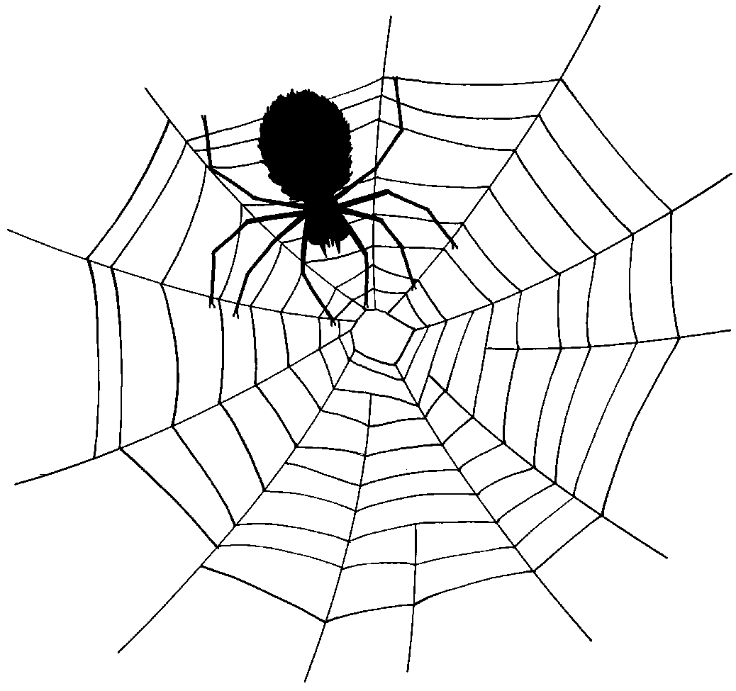
Scrapy spiders
Spiders are the place where you define the custom behaviour for crawling and parsing pages for a particular site (or, in some cases, a group of sites).
http://doc.scrapy.org/en/latest/topics/spiders.html

Slide 15
Scrapy spiders cont’d
class ExampleSpider(scrapy.Spider):
name = "example"
allowed_domains = ["example.com"]
start_urls = ['http://www.example.com/’]
def parse(self, response):
...
process response
...

Slide 16
Scrapy spiders cont’d
Process response using selectors
xpath()
css()
extract()
re()
Follow links
yield scrapy.Request(url, callback=self.parse_link)

Slide 17
Scrapy item pipelines
After an item has been scraped by a spider, it is sent to the Item Pipeline which processes it through several components that are executed sequentially.
http://doc.scrapy.org/en/latest/topics/item-pipeline.html

Slide 18
Scrapy item exporters
Default exporters:
'json': 'scrapy.exporters.JsonItemExporter'
'jsonlines': 'scrapy.exporters.JsonLinesItemExporter'
'jl': 'scrapy.exporters.JsonLinesItemExporter'
'csv': 'scrapy.exporters.CsvItemExporter'
'xml': 'scrapy.exporters.XmlItemExporter'
'marshal': 'scrapy.exporters.MarshalItemExporter'
'pickle': 'scrapy.exporters.PickleItemExporter’
http://doc.scrapy.org/en/latest/topics/exporters.html

Slide 19
Scrapy - the devil is in the details
settings.py
LOG_LEVEL = 'INFO’
FEED_EXPORTERS = {'json': 'wiki_logs.exporters.UnicodeJsonItemExporter'}
Create a custom JSON exporter because the builtin one is brain damaged and forces ASCII output
ROBOTSTXT_OBEY = False
or, be polite and respect robots.txt

Slide 20
How to Crawl the Web Politely
What Makes a Crawler Polite?
A polite crawler respects robots.txt
A polite crawler never degrades a website’s performance
A polite crawler identifies its creator with contact information
A polite crawler is not a pain in the buttocks of system administrators
https://blog.scrapinghub.com/2016/08/25/how-to-crawl-the-web-politely-with-scrapy/

Slide 21
robots.txt example
https://wikitech.wikimedia.org/robots.txt
# robots.txt for http://www.wikipedia.org/ and friends
#
# Please note: There are a lot of pages on this site, and there are
# some misbehaved spiders out there that go _way_ too fast. If you're
# irresponsible, your access to the site may be blocked.
#

Slide 22
Scrapy command line tool
> scrapy shell --nolog http://fivethirtyeight.com/
>>> view(response)
>>> response.xpath(‘//a/@href’).extract()

Slide 23
Scrapy crawler demo
> scrapy startproject fivethirtyeight
> cd fivethirtyeight
> scrapy genspider fivethirtyeight_spider fivethirtyeight.com
> scrapy crawl --nolog fivethirtyeight_spider -t json -o output.json

Slide 24
Links
Code:
https://github.com/mihaitodor/wikipedia_logs_crawler
Dataset snapshot:
https://github.com/mihaitodor/datasets/tree/master/wiki_logs

Slide 25
Thank you!
Any questions? ☺

